Slide 1

CEPP STUDENT ORIENTATION
School of Foreign Languages
2024-2025 Academic Year
CEPP (Compulsory English Preparatory Program)
Bartın University
ydyo@bartin.edu.tr
www.bartin.edu.tr
Bartın, Sept. 23, 2023

Slide 2


TO SCHOOL OF FOREIGN LANGUAGES (SFL)

Slide 3
Life in Bartın
A safe and peaceful city awaits BARU students.
Bartın province and its surroundings are a natural wonder.
While you can swim in unique areas such as Amasra, Kurucaşile, and İnkumu, you can also spend quality time in the forests surrounding us.

Slide 4
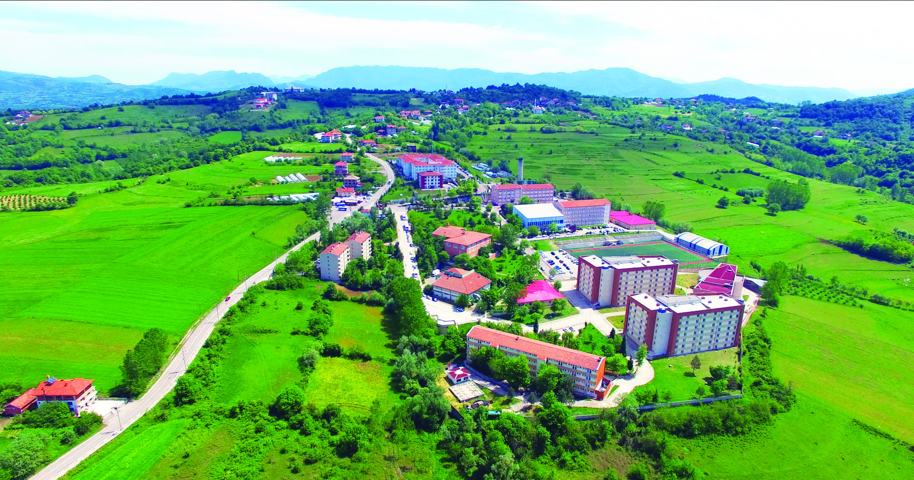
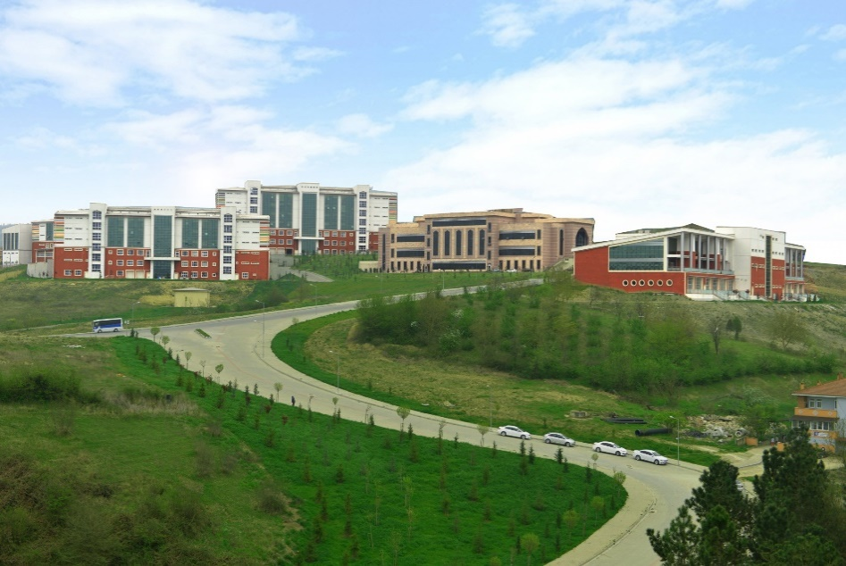
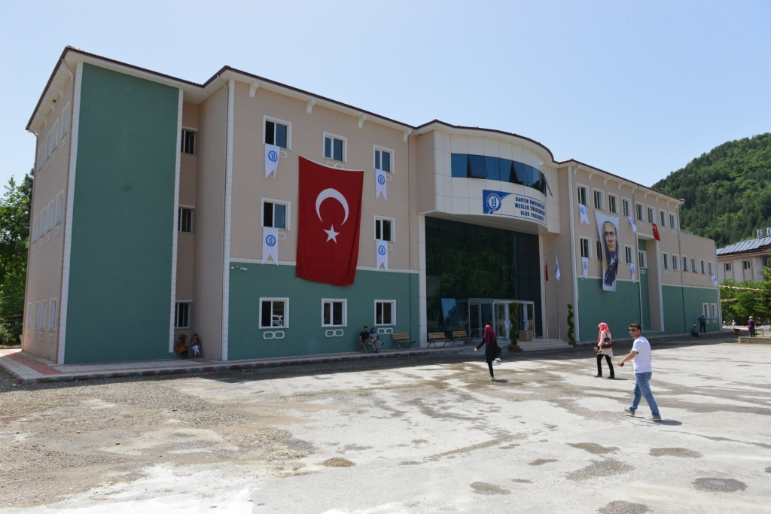
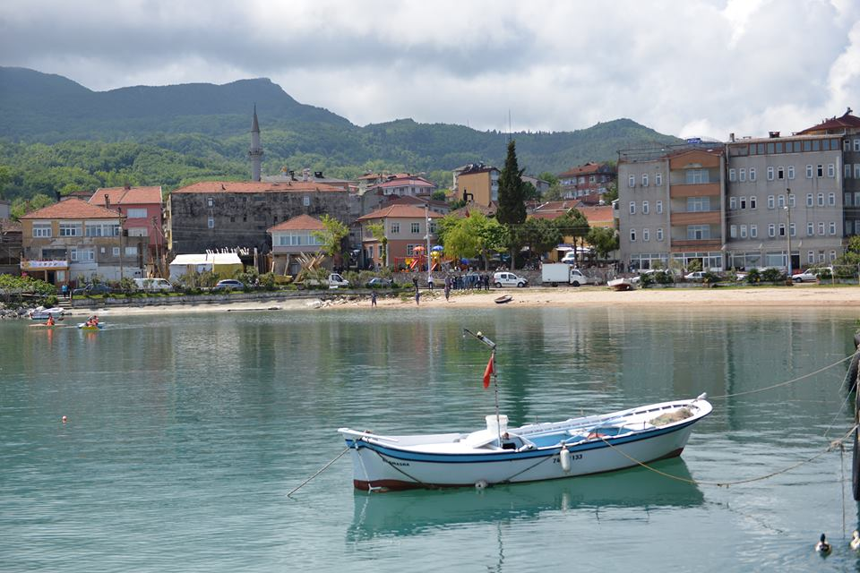
Ağdacı Campus
Kutlubey Campus
Campuses: Ağdacı
Kutlubey
Ulus
Kurucaşile
Academic Units: 9 Faculties
1 Graduate School
3 Vocational Schools
1 School of Foreign Languages
Ulus Campus
Kurucaşile Campus

Slide 5
TRANSPORT
How to reach campuses
Ağdacı Campus and Kutlubey Campus can be reached by public transportation.
City buses leave from the city center at regularly scheduled times.
Buses arrive at Ağdacı campus in 15-20 minutes and at Kutlubey Campus in 25 minutes.
https://bartinozelhalkotobusleri.com/guzergahlar

Slide 6


LIBRARY
Libraries on Ağdacı Campus and Kutlubey Campus
https://kutuphane.bartin.edu.tr/

Slide 7
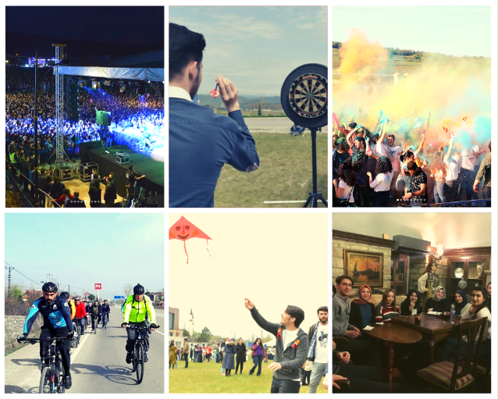
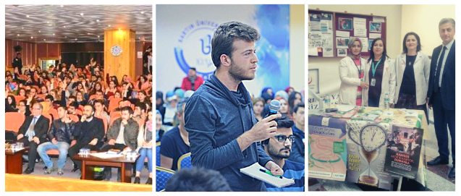
SOCIAL FACILITIES & STUDENT CLUBS
50+ student clubs
Conferences, Seminars, Spring Festival

Slide 8

https://barcev.bartin.edu.tr/
https://els.bartin.edu.tr/
https://yabancidillerkulubu.bartin.edu.tr/

Slide 9
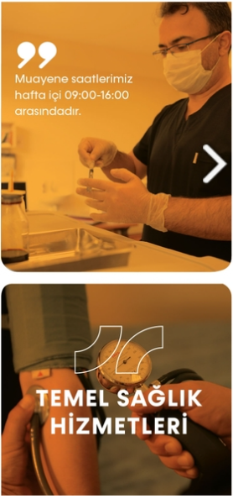
MEDICAL SERVICE
Sağlık, Kültür ve Spor Daire Başkanlığı
On Kutlubey Campus
MEDIKO
Faculty of Letters (Administrative Building, 1st Floor)
  https://sksdb.bartin.edu.tr/saglik-hizmeti.html
  1 doctor
  1 psychologist
  1 dietician
  2 nurses
Psychological Counseling and Guidance Research and Application Center
Faculty of Education (Administrative Building, 3rd Foor)
  https://pdrem.bartin.edu.tr/

Slide 10
Psychological Counseling
Psychological Counseling and Guidance Application and Research Center
On Kutlubey Campus
This center located on the 3rd floor of the Faculty of Education building provides service between 09.00-17.00 on weekdays.
  https://pdrem.bartin.edu.tr/ ALSO CLICK HERE TO WATCH PROMOTIONAL VIDEO
Services
Individual Psychological Counseling: A professional assistance process carried out to support individuals' social-emotional, academic and career development and to contribute to the solution of problems they experience in their interpersonal relationships. Sessions planned once a week last approximately 45-50 minutes. The total number of sessions that can be used is determined as 8-10.
Group Counseling: A psychological counseling service conducted with a group consisting of a leader (psychological counselor) and 8-12 members. It aims to develop interpersonal relationships, focuses on the feelings, values ​​and attitudes of the members and also strives to achieve the purpose of each member coming to the group. It enables individuals to realize their problems and produce solutions to these problems by receiving feedback in a supportive environment. They are held for an average of 6-10 weeks, one session per week, each planned to be approximately 1.5 hours.

Slide 11

FIGHT AGAINST ADDICTION
TYPES OF ADDICTION
Alcohol addiction
Technology addiction
Drug addiction
Tobacco addiction
Click the link below to read more about addictions and their hazards.
https://ydyo.bartin.edu.tr/bagimlilikla-mucadele.html
https://www.tbm.org.tr/

Slide 12

DOUBLE MAJOR & MINOR PROGRAMS
Double diplomas from two majors
Check the website of Bartın University Registrar's Office for information about double major & minor (legislation, quota, etc.).
EDUROAM
EDUROAM is short for Education Roaming. Eduroam is the secure, world-wide roaming access service developed for the international research and education community to connect network at both Bartın University and other educational institutions.
For more information, click here or visit the website of IT department of BARU)

Slide 13

PART-TIME JOBS
Working in administrative offices
15 hours per week, a total of 60 hours in a month
For more information: the website of the Department of Health, Culture and Sports
STUDENT MOBILITY
Erasmus, Farabi & Mevlana Exchange Programs
Mobility for studies
Mobility for traineeship
Requirements:
CGPA 50% + Language Proficiency 50%

Slide 14

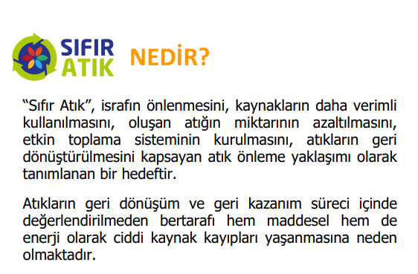
RIMER
Better communication between the school administration, academic staff and the students
For your demands, wishes, suggestions and complaints
ZERO WASTE POLICY
"Zero Waste" is an approach to resource and waste management based on circularity.
It promotes sustainable production and consumption habits and encourages the efficient use of resources.
Zero waste entails avoiding wastefulness and advocating for the prevention, reduction, reuse, and recycling of waste.

Slide 15

SCHOOL OF FOREIGN LANGUAGES (SFL)
Services
founded in 2018
offering English courses to students in two programs
As of 2019-2020 academic year, CEPP admitting students from the departments of ETI and ELT
Our Mission
to offer high-quality and innovative English curriculum for our students,
to educate creative, dynamic and efficient individuals who use English as a communication tool in reading, writing, listening and speaking,
to equip our students with lifelong learning skills,
to make them autonomous learners

Slide 16
SCHOOL OF FOREIGN LANGUAGES
Where you can find us
Location: Ağdacı Campus.
  Administrative and instructor offices: Ground Floor in the building of Faculty of Forestry
  Classrooms: SBF Classrooms, 1st Floor in the building of Faculty of Health Sciences
Phone: 0378 501 1000 (Extension: 2535)
E-mail: ydyo@bartin.edu.tr

Slide 17
SCHOOL OF FOREIGN LANGUAGES
Academic Staff
Director: Koray TİRYAKİ
  Assist. Directors: Murat KÖROĞLU – Niyazi Alkan AY
  Department Head: Hüma Tuğçe YÜCELLİ
  School Secretary: Leyla AYDIN
  Officers for Student Affairs: Onur KÖMÜRCÜ, Murat YAMAN, Birgül ÖZDEMİR

Slide 18
SCHOOL OF FOREIGN LANGUAGES
What is CEPP?
stands for Compulsory English Preparatory Program
a two-semester program
offers a preparatory language education in English to students from ELT and ETI
different from OEPP (İsteğe Bağlı Hazırlık Programı)

Slide 19
CEPP EDUCATION AT SFL
Language Levels
Language education and assessment in the School of Foreign Languages concerns the standards defined by the Common European Framework of Reference for Languages (CEFR).
The compulsory preparatory class aims to complete 2 levels (CEFR B2 and C1).
The School of Foreign Languages is committed to enabling the students in the CEPP to reach level C1 at any skill.

Slide 20
ACADEMIC CALENDAR
2024-2025 CEPP ACADEMIC YEAR
FALL SEMESTER
Proficiency Test | September 19-20, 2024
Student Orientation | September 23, 2024 (Week 1)
Instruction begins | September 25, 2024 (Week 1)
Vocab Quiz I (PBT) | Pop Quiz (unspecified date)
Quiz I (OP) | November 11-15, 2024 (Week 8)
Vocab Quiz II (PBT) | Pop Quiz (unspecified date)
Quiz II (DEB) | January 6-10, 2025 (Week 16)
Midterm Exam (PBT) | January 6-10, 2025 (Week 16)
PP | January 6-10, 2025 (Week 16)
Winter Break | January 11 – February 17, 2025
Abbreviations:
PBT= Paper Based Test
OP= Oral Presentation
PP= Portfolio Presentation
DEB= Debate

Slide 21
ACADEMIC CALENDAR
2024-2025 CEPP ACADEMIC YEAR
SPRING SEMESTER
Instruction begins | February 17, 2025 (Week 1)
Vocab Quiz III (PBT) | Pop Quiz (unspecified date)
Quiz III (PBT) | March 10-14 (Week 4)
Vocab Quiz IV (PBT) | Pop Quiz (unspecified date)
Midterm Exam (TP) | April 7-11, 2025 (Week 8)
Quiz IV (PBT) | May 5-9, 2025 (Week 12)
PP | June 14-22, 2025 (Week 18)
Final Exam | June 14-22, 2025 (Week 18)
Abbreviations:
PBT= Paper Based Test
PP= Portfolio Presentation
TP= Theatrical Play

Slide 22
COURSES
CEPP Courses
INSTRUCTORS/ADVISORS | COURSES | WEEKLY HOURS
İbrahim Kayacan | Haz. 102 Main Course | 12
Sevcan Akyıldız
Hüma Tuğçe Yücelli
Burçin Kef
Preeti Chemiti | Haz. 103 Listening & Speaking | 4
Esma Nur Dikmen | Haz. 104 Reading & Writing | 4
Gamze Ar

Slide 23
COURSE MATERIALS
CEPP Course Materials
COURSES | COURSE MATERIALS | SEMESTERS
COURSE |  | I. SEMESTER | II. SEMESTER
Main Course | New Language Leader | B2 | B2+
Reading & Writing | Ready to Write | Level 3
Listening & Speaking | Contemporary Topics | Level 1 | Level 2

Slide 24





CEPP EDUCATION AT SFL
Course Materials
Not Alanı

Slide 25
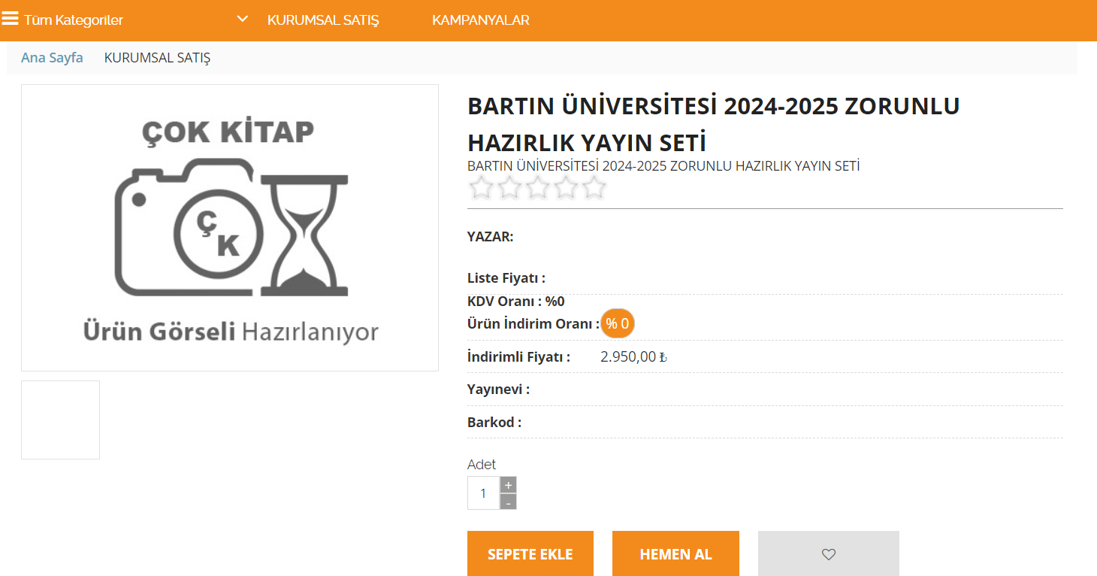
CEPP EDUCATION AT SFL
How to Obtain Course Materials
https://www.çokkitap.com/bartin-universitesi-2024-2025-zorunlu-hazirlik-yayin-seti_5093.html
According to copyright law, using pirated books and duplicating and using original books without permission requires criminal sanctions.

Slide 26
CEPP EDUCATION AT SFL
Online Platforms
Announcements and updates about exams, schedules, events, and assignments are shared on digital platforms and Microsoft Teams groups.
  https://ydyo.bartin.edu.tr
  https://www.facebook.com/BartinYdyo/
  https://www.instagram.com/baru_ydyo/
  https://x.com/BARU_YDYO
Each student is assigned an Office 365 account
  All announcements, assignments and exams to be published on Microsoft Teams,
  Please activate your accounts.
MyEnglishLab
For more details, please check the link below:
  https://w3.bartin.edu.tr/duyurular/office-365-hesaplari-hakkinda.html

Slide 27
CEPP EDUCATION AT SFL
Rights and Responsibilities
IN CLASS
  Attendance (at least %85)
  Participation
  Assignments
  Course materials
  Professional attitude
  Classroom policies
OUTSIDE THE CLASS
  Microsoft Teams
  Office hours
  Email
  WhatsApp
REGULARLY CHECK
  Student Handbook
  Key Dates and Events
  Course Requirements
  Weekly Schedule
  School Directive
    https://ydyo.bartin.edu.tr/hazirlik-siniflari/hazirlik-siniflari-yonergesi.html
  Our website
    https://ydyo.bartin.edu.tr/
    https://fla.bartin.edu.tr/

Slide 28
CEPP EDUCATION AT SFL
Assessment
PREPARATORY CLASS ASSESSMENT CRITERIA
I. TERM | %
I. & II. Quiz | 10
I. & II. Vocabulary Quiz | 2
I. Midterm | 10
Portfolio | 3
II. TERM
I. & II. Quiz | 10
I. & II. Vocabulary Quiz | 2
II. Midterm | 10
Portfolio | 3
FINAL EXAM (MAKE-UP EXAM) | 50
TOTAL | 100
CEPP
achievement conditions
the final exam grade ≥ 50 out of 100
Sum of all grades within year ≥ 75 out of 100
(quizzes + midterms + portfolios + final exam)
Not Alanı

Slide 29
CEPP EDUCATION AT SFL
Assessment
Vocab Quizzes
  pop-up quiz
  (without due notice & 2 sessions each semester)
  paper-based test
Quizzes
  1st quiz: oral presentation (Fall)
  2nd quiz: debate (Fall)
  3rd quiz: paper-based test (Spring)
  4th quiz: paper-based test (Spring)
Midterms
  Fall Midterm:
    paper-based test (skills & language use)
    At the end of fall semester
  Spring Midterm:
    theatrical performance
    Mid-semester
Final Exam
  End of academic year
  85% attendance required
  50% in-semester assessment success required
Portfolio Presentation (end of each semester)
  Oral presentation
  Written presentation
  Assignment submission
  Overall performance grade
Not Alanı

Slide 30
Rights and Responsibilities
Attendance
85% attendance for the courses is MANDATORY during the academic year! Those missing over 84 hours in the academic year fail the CEPP and are not allowed to take the final exam.
The committee health reports received from hospitals are valid only for exams.
Attendance will be announced weekly, but it is your responsibility to keep a record of your attendance.
Attendance is not required for repeat students (You may submit a petition and study for YDS, YÖKDİL, TOEFL, etc.)

Slide 31
Rights and Responsibilities
Instructions & Class Rules
Instruction & class rules will be hung at the door
Pair & group tasks required both in and outside the class
Being late for the first 5 mins acceptable only for the first lesson in the morning
- if you are too late, please do not interrupt the instruction. Latecomers will not sign the attendance sheet.
Always sit with a partner
Do not leave the front desks empty
Grammar & Speaking worksheets per week
- The completion will influence your overall progress grade.

Slide 32
CEPP EDUCATION AT SFL
Exemption from CEPP
Newly enrolled and repeat students take the Proficiency (Exemption) Exam each September
Successful students are exempt from the CEPP
  In-semester exemption: 75 grade points out of 100 in both semesters
  Off-semester exemption: YDS or equivalent test results (YÖKDİL, TOEFL, etc.)
The final grade achieved at CEPP does not affect the overall GPA.
Students meeting the exemption conditions stated in Article 14 must submit the original or an approved copy of their documents to the Directorate of SFL with their petitions.
  (Paragraphs 2, 3 and 4) of our School Directive (https://ydyo.bartin.edu.tr/hazirlik-siniflari/hazirlik-siniflari-yonergesi.html)

Slide 33
CEPP EDUCATION AT SFL
How you will be assessed in the exams

Slide 34
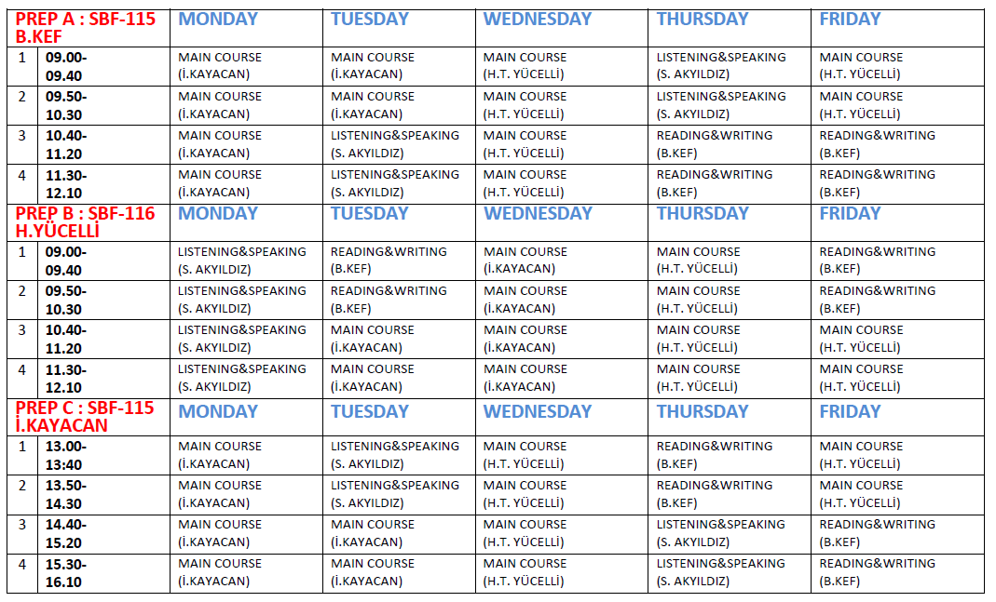
CEPP EDUCATION AT SFL
Weekly Schedule
Weekly Schedule for the Fall Semester will be announced at ydyo.bartin.edu.tr on September 23, 2024 (by 17.30)

Slide 35
CEPP EDUCATION AT SFL
Repeat Students
Students who will receive preparatory education for the second time are required to pay their tuition fees and renew their registration.

Slide 36
What we expect from our students
Code of Conduct
Requests, Suggestions, and Complaints (Use channels like RIMER)
Contacting Instructors
Academic Integrity
Attendance, Participation & Punctuality
Showing Respect for Others
Responsible Use of Resources & Technology
Privacy and Confidentiality
Diversity and Inclusion
Social Media Usage

Slide 37
What our students may expect from us
Student expectations
Effective Instruction and Clear Communication
Supportive Environment
Timely Feedback
Accessibility
Fair Assessment
Professional Development
Respect for Students

Slide 38
Any questions?
Please ask your questions about the topics covered in this orientation or any other topics that interest your education at CEPP/BARU.

Slide 39
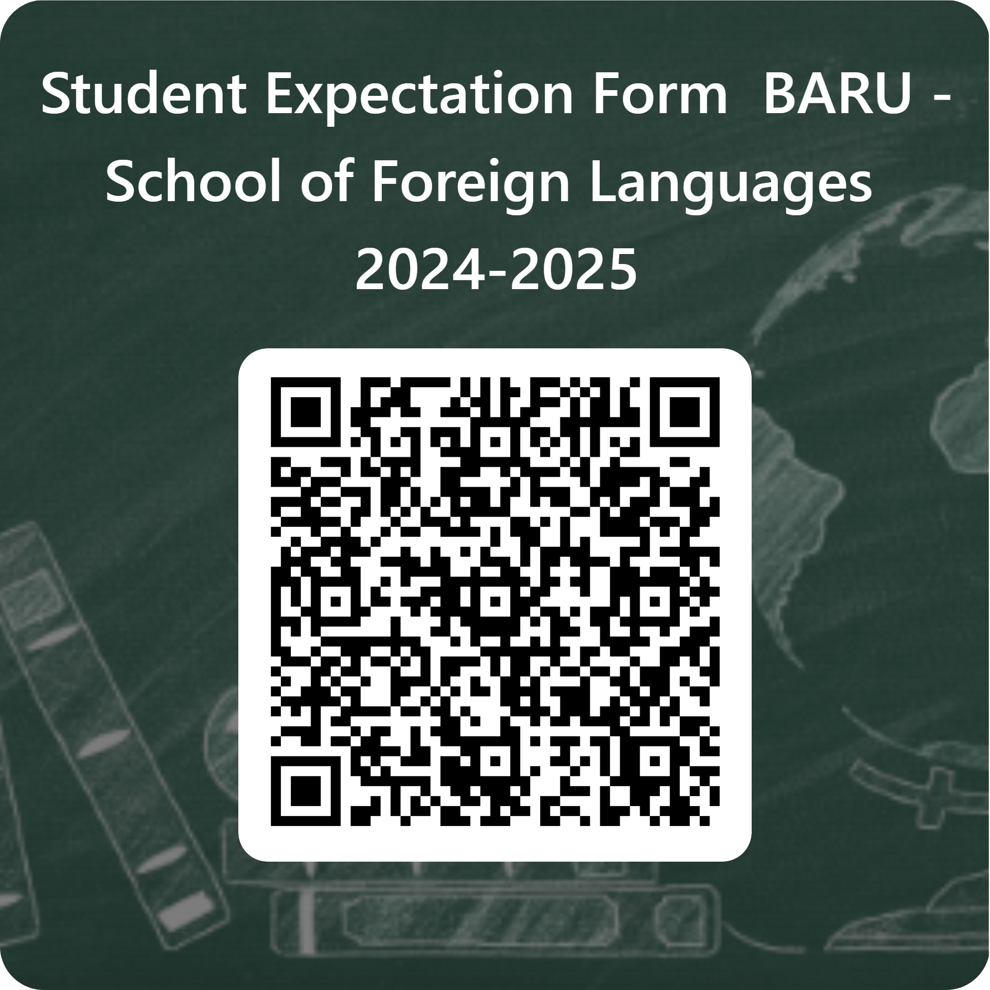
What our students may expect from us
Share your expectations and what we need to consider
Share your expectations, wishes, request or what we need to consider in your learning journey. Your thoughts will be kept confidential.
Write in either language (TR or ENG).
Use either way to do so.
  Write by hand on the paper sheet delivered by your instructor.
  Complete the online form (Scan the QR to see the form)
  Click Here OR Scan QR
  https://forms.office.com/r/LRePsYTsrg

Slide 40

WISH YOU SUCCESS
for the new academic year
THE SCHOOL OF FOREIGN LANGUAGES

