Slide 1

Bartin University
Welcome to the Department of Forest Engineering

Slide 2
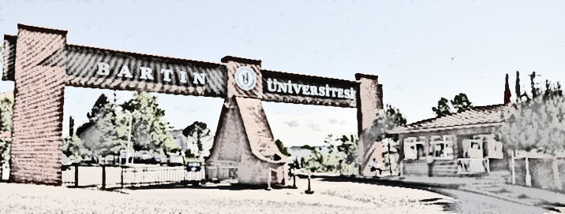
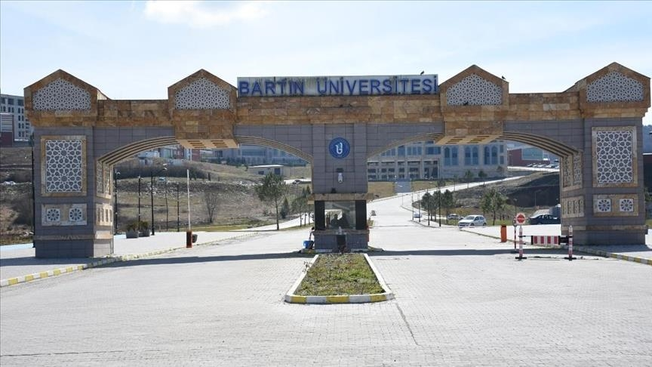
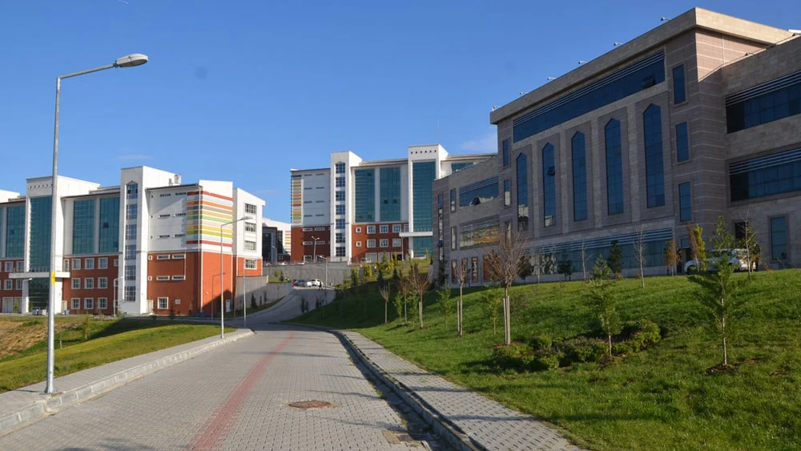
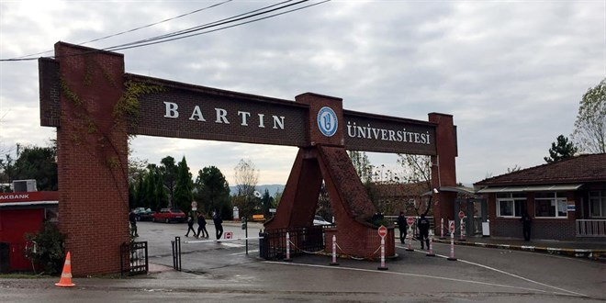
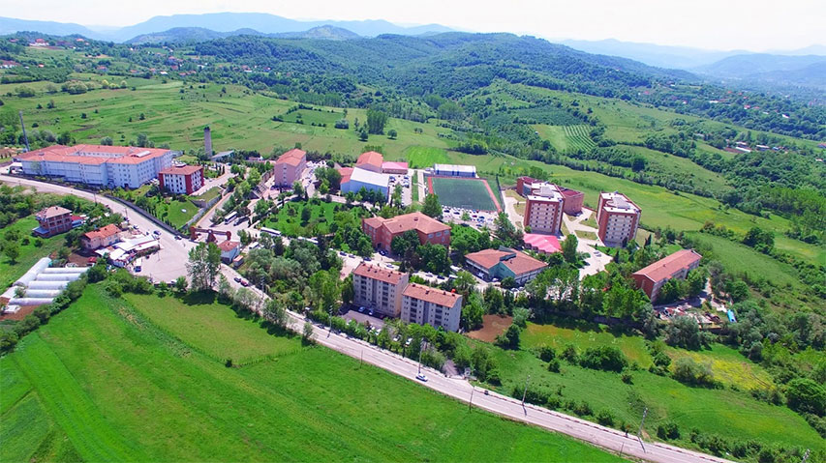

Slide 3
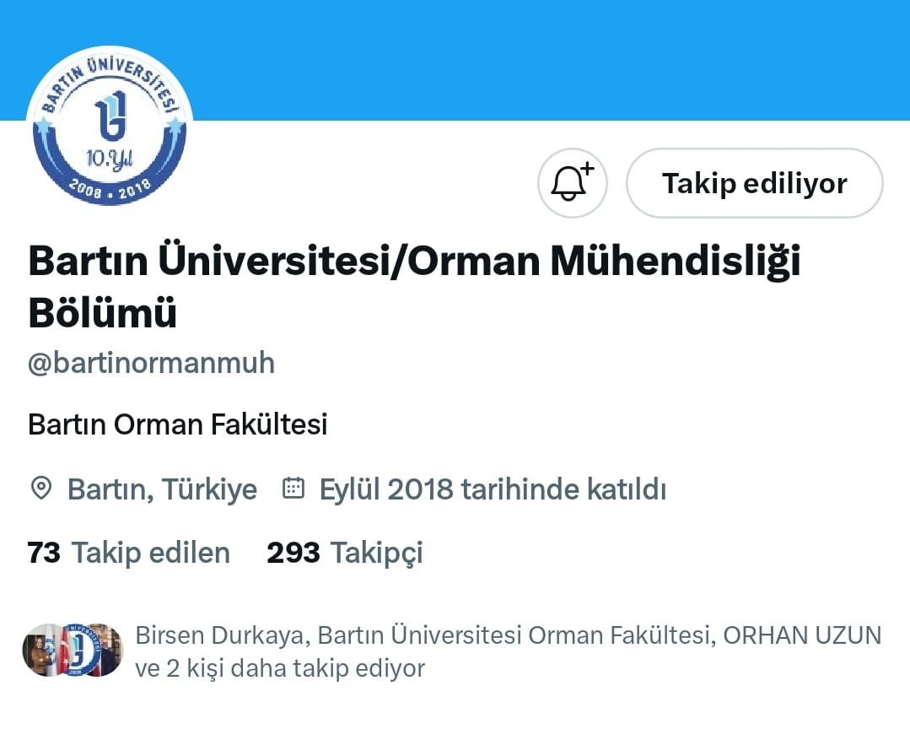
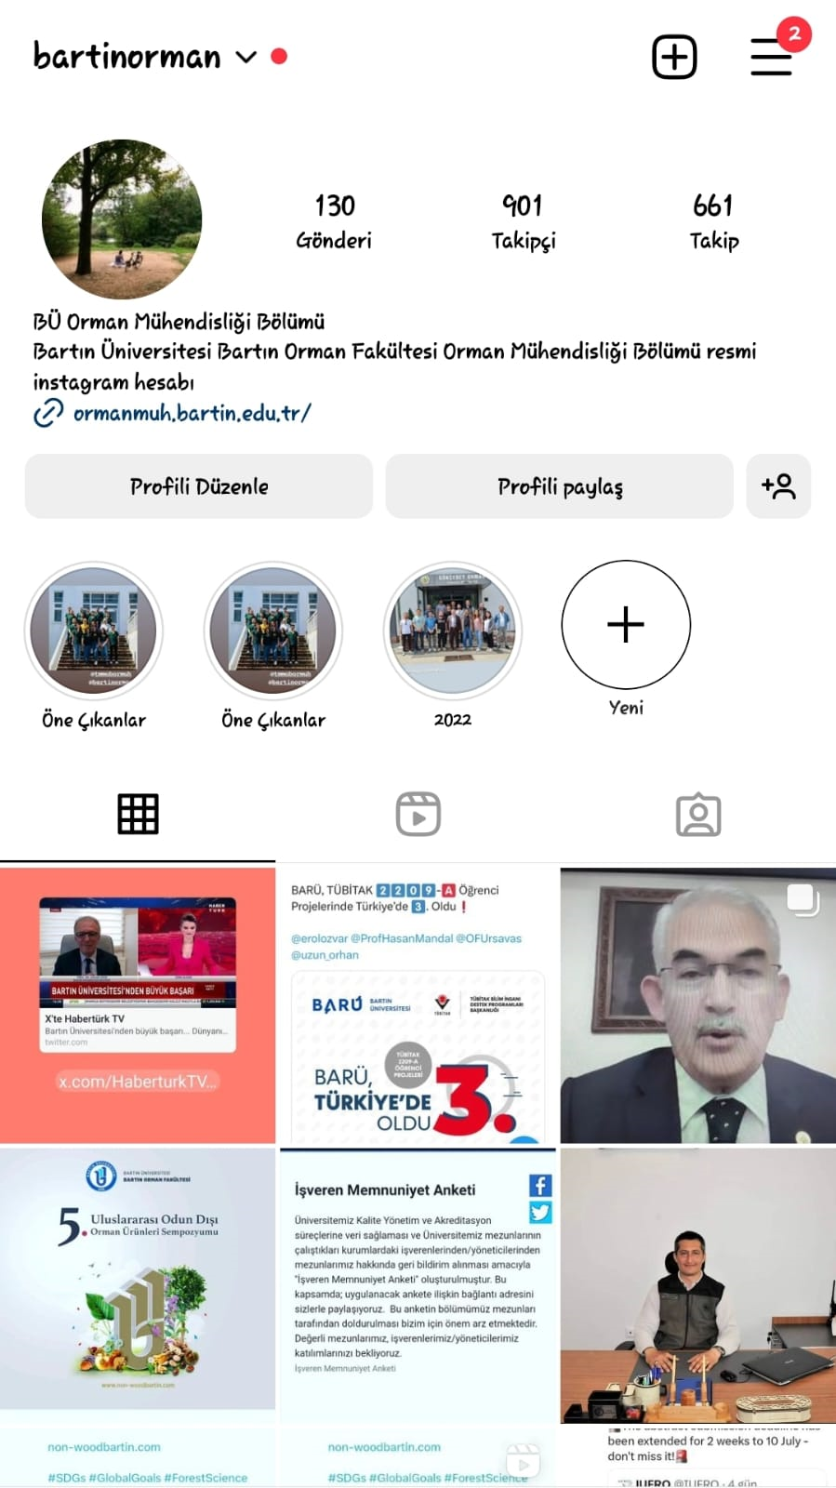
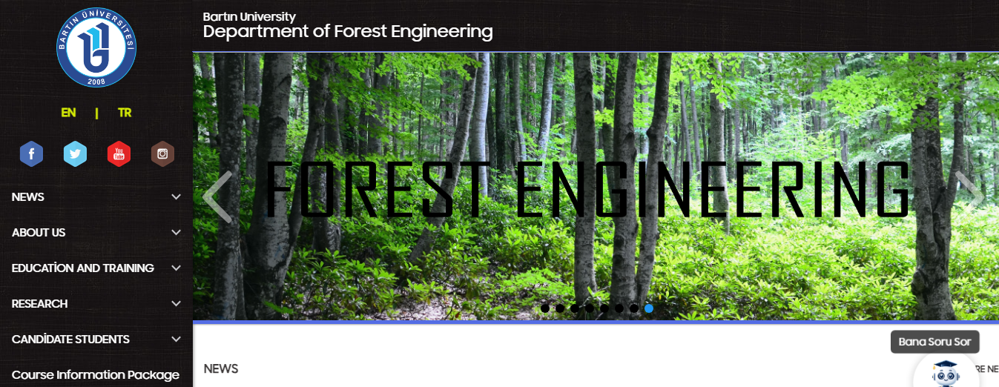
Social Media

Slide 4
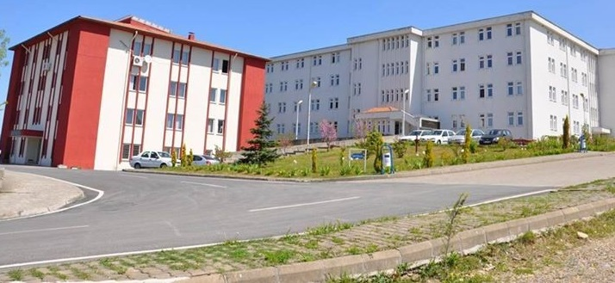
Faculty of Forestry was established in 1992, affiliated with Zonguldak Karaelmas University. Our department, which started its education life in 1993, had its first graduates in 1997. It continues its activities by connecting to our university on 22 May 2008.

Slide 5
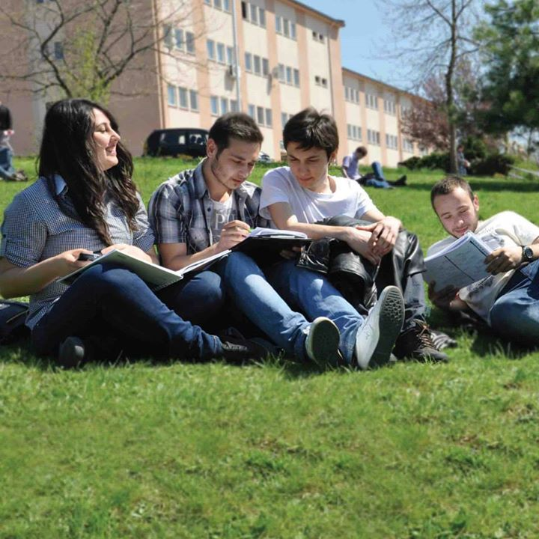
Yıllar | Kontenjan | Yerleşme
2008 | 113 | 113
2009 | 118 | 118
2010 | 118 | 118
2011 | 118 | 118
2012 | 123 | 29
2013 | 62 | 10
2014 | 11 | 11
2015 | 31 | 13
2016 | 21 | 21
2017 | 21 | 21
2018 | 30 | 11
2019 | 25 | 35
2020 | 30 | 31
2021 | 30 | 28
2022 | 30 | 30
2023 | 30 | 30
BARTIN UNIVERSITY FACULTY OF FORESTRYDepartment of Forest EngineeringQuotas and Settlements by Years

Slide 6
OUR MISSION
The mission of the Forest Engineering undergraduate program at Bartın University, Faculty of Forestry is to train engineers and researchers who are familiar with the establishment, management, operation of forests, standardization, quality control and marketing of processed forest products, who have the ability to use modern engineering tools to analyze and solve the problems they encounter, and who have the ability to match their knowledge with practice.
To produce nationally and internationally accepted knowledge and contribute to technological development in the field of Forest Engineering Science in parallel with contemporary and current developments.

Slide 7
OUR VISION
The vision of our department is to become a respected, high-quality, accredited education and research center not only on a national scale but also internationally with all its departments;
To transform the knowledge gained into social and industrial benefit,
To be able to follow global developments and at the same time have the courage to compete,
To be able to adapt to interdisciplinary work environments, to produce solutions by collaborating with stakeholders in professional solutions, to be able to express themselves in the best way in their field, to have self-confidence,
To be able to conduct basic experimental studies in their field and evaluate the data they obtain, to have investigative characteristics and to have learned the principles of accessing information,
To be successful in written and verbal communication, to be able to express themselves in the best way, to be more prominent in their own fields of work, to have persuasion skills and self-confidence,
To be beneficial to their country and humanity, to train undergraduate and graduate students.
To follow scientific and technological developments related to its field in our country and in the world,
To ensure that our country and the forest products industry sector become a leader and strong in the national and international arena with undergraduate and graduate education and training activities,
To be the superior and best education-training department in our country with its corporate culture, values ​​and quality.

Slide 8
DEPARTMENT OF FOREST ENGINEERING
Academic staff
11 Professors,
8 Associate Professors,
3Dr. Lecturer of Member
4 Research Assistants
There are 26 faculty members including:

Slide 9
There are 11 departments in the Department of Forest Engineering
Forest Botany
Forest Management
Watershed Management
Forest Entomology and Conservation
silvicultureForestry
EconomicsForestry
Policy
Forestry Law
Soil science and Forest Ecology
Forest Construction and Transportation
Measurement Information and Cadastre

Slide 10


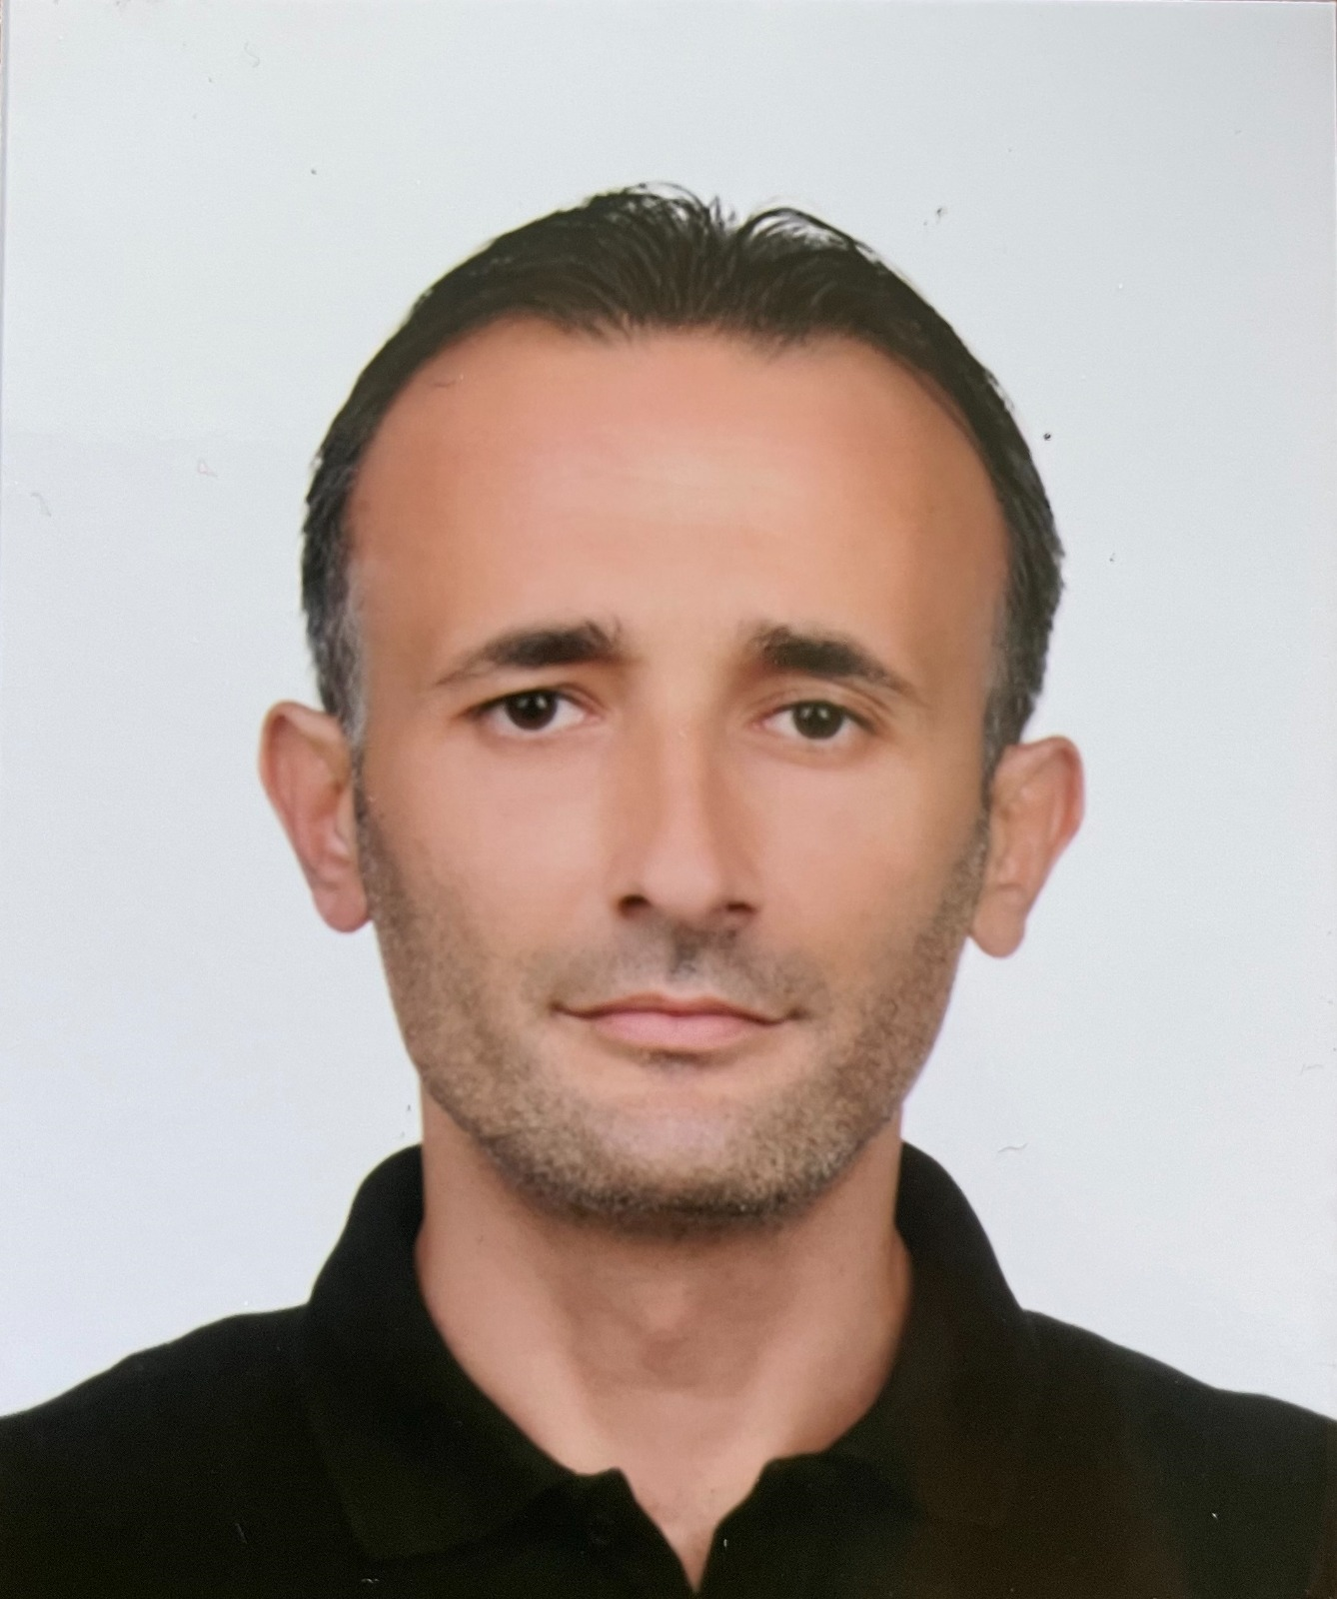
DEPARTMENT OF FOREST ENGINEERING
Prof. Dr. Ayhan Ateşoğlu
Head of department
Doç. Dr. N. Kaan ÖZKAZANÇ
Deputy head of department
Doç. Dr. Sinan KAPTAN
Deputy head of department

Slide 11
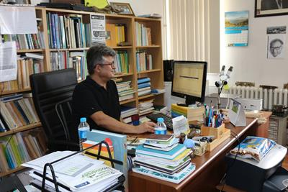
Department of Forest Botany
Prof. Dr. Barbaros YAMAN Arş. Gör. Esra PULAT
Head of department

Slide 12
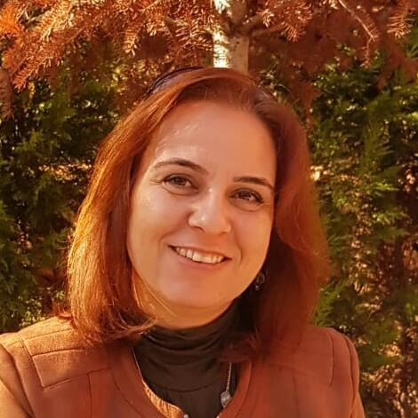
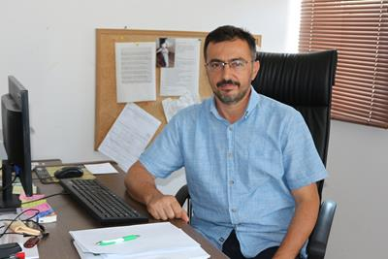
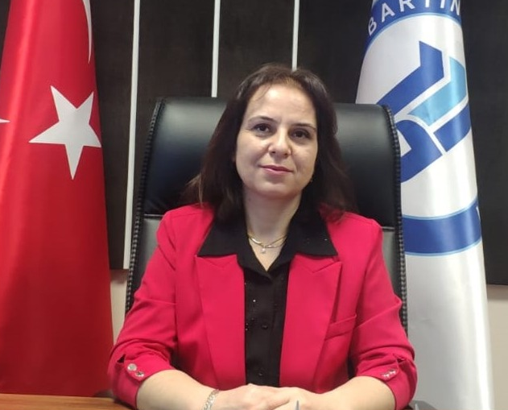
Department of Forest Management
Doç. Dr. Sinan KAPTAN
Prof. Dr. Ali DURKAYA
Head of department
Prof. Dr. Birsen DURKAYA
Orman Fakültesi Dekanı

Slide 13
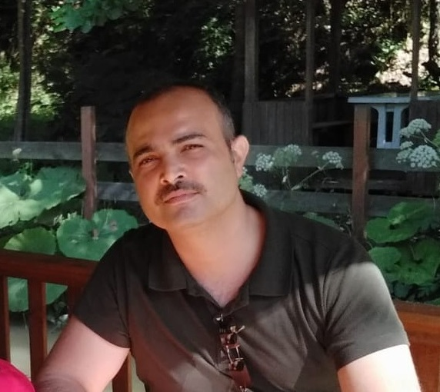
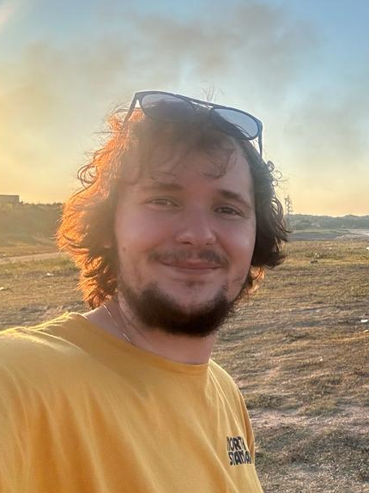
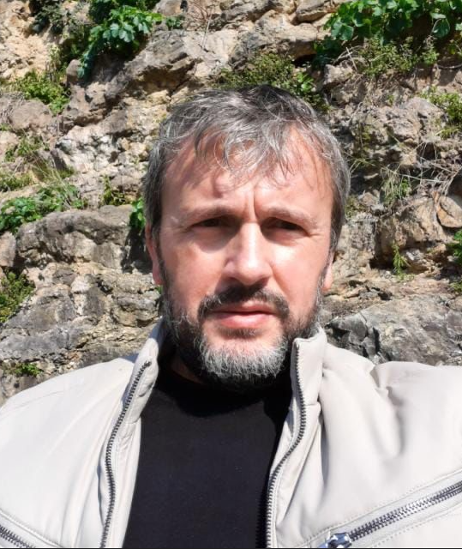
Havza Amenajmanı Anabilim Dalı
Doç. Dr. Şahin PALTA
Head of department
Vice-Dean
Arş. Gör. Eren BAŞ Dr. Öğr. Üyesi Hüseyin ŞENSOY

Slide 14
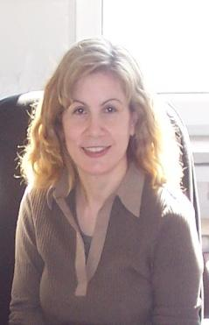
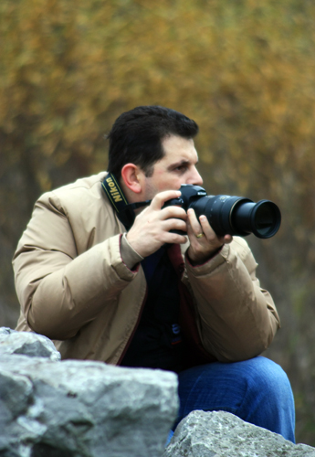
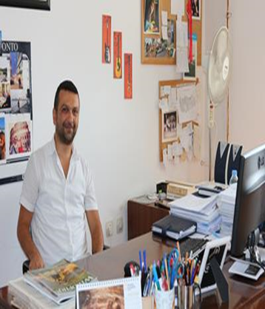
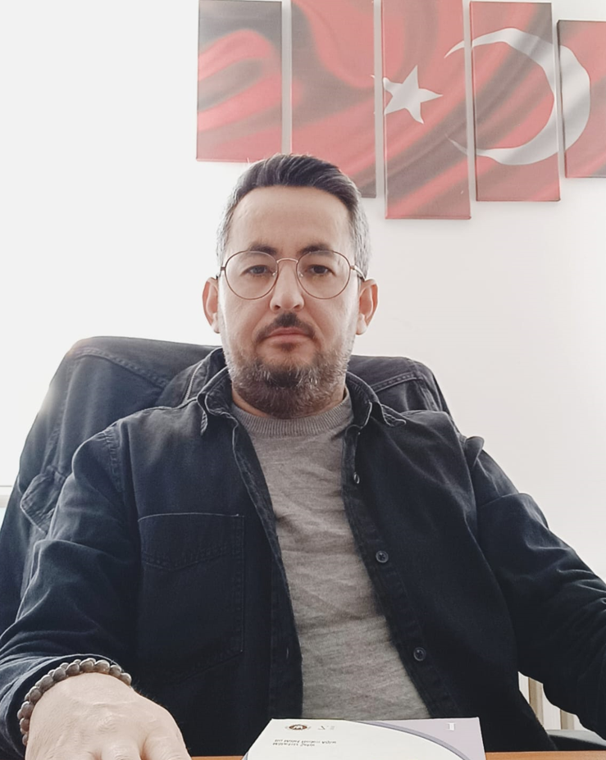
Orman Entomolojisi ve Koruma Anabilim Dalı
Prof. Dr. Azize TOPER KAYGIN
Head of department
Doç. Dr. Nuri Kaan ÖZKAZANÇ
Doç. Dr. Mertol ERTUĞRUL
Doç. Dr. Yafes YILDIZ

Slide 15
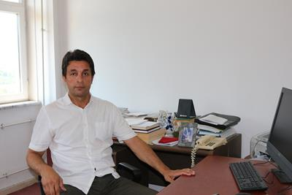
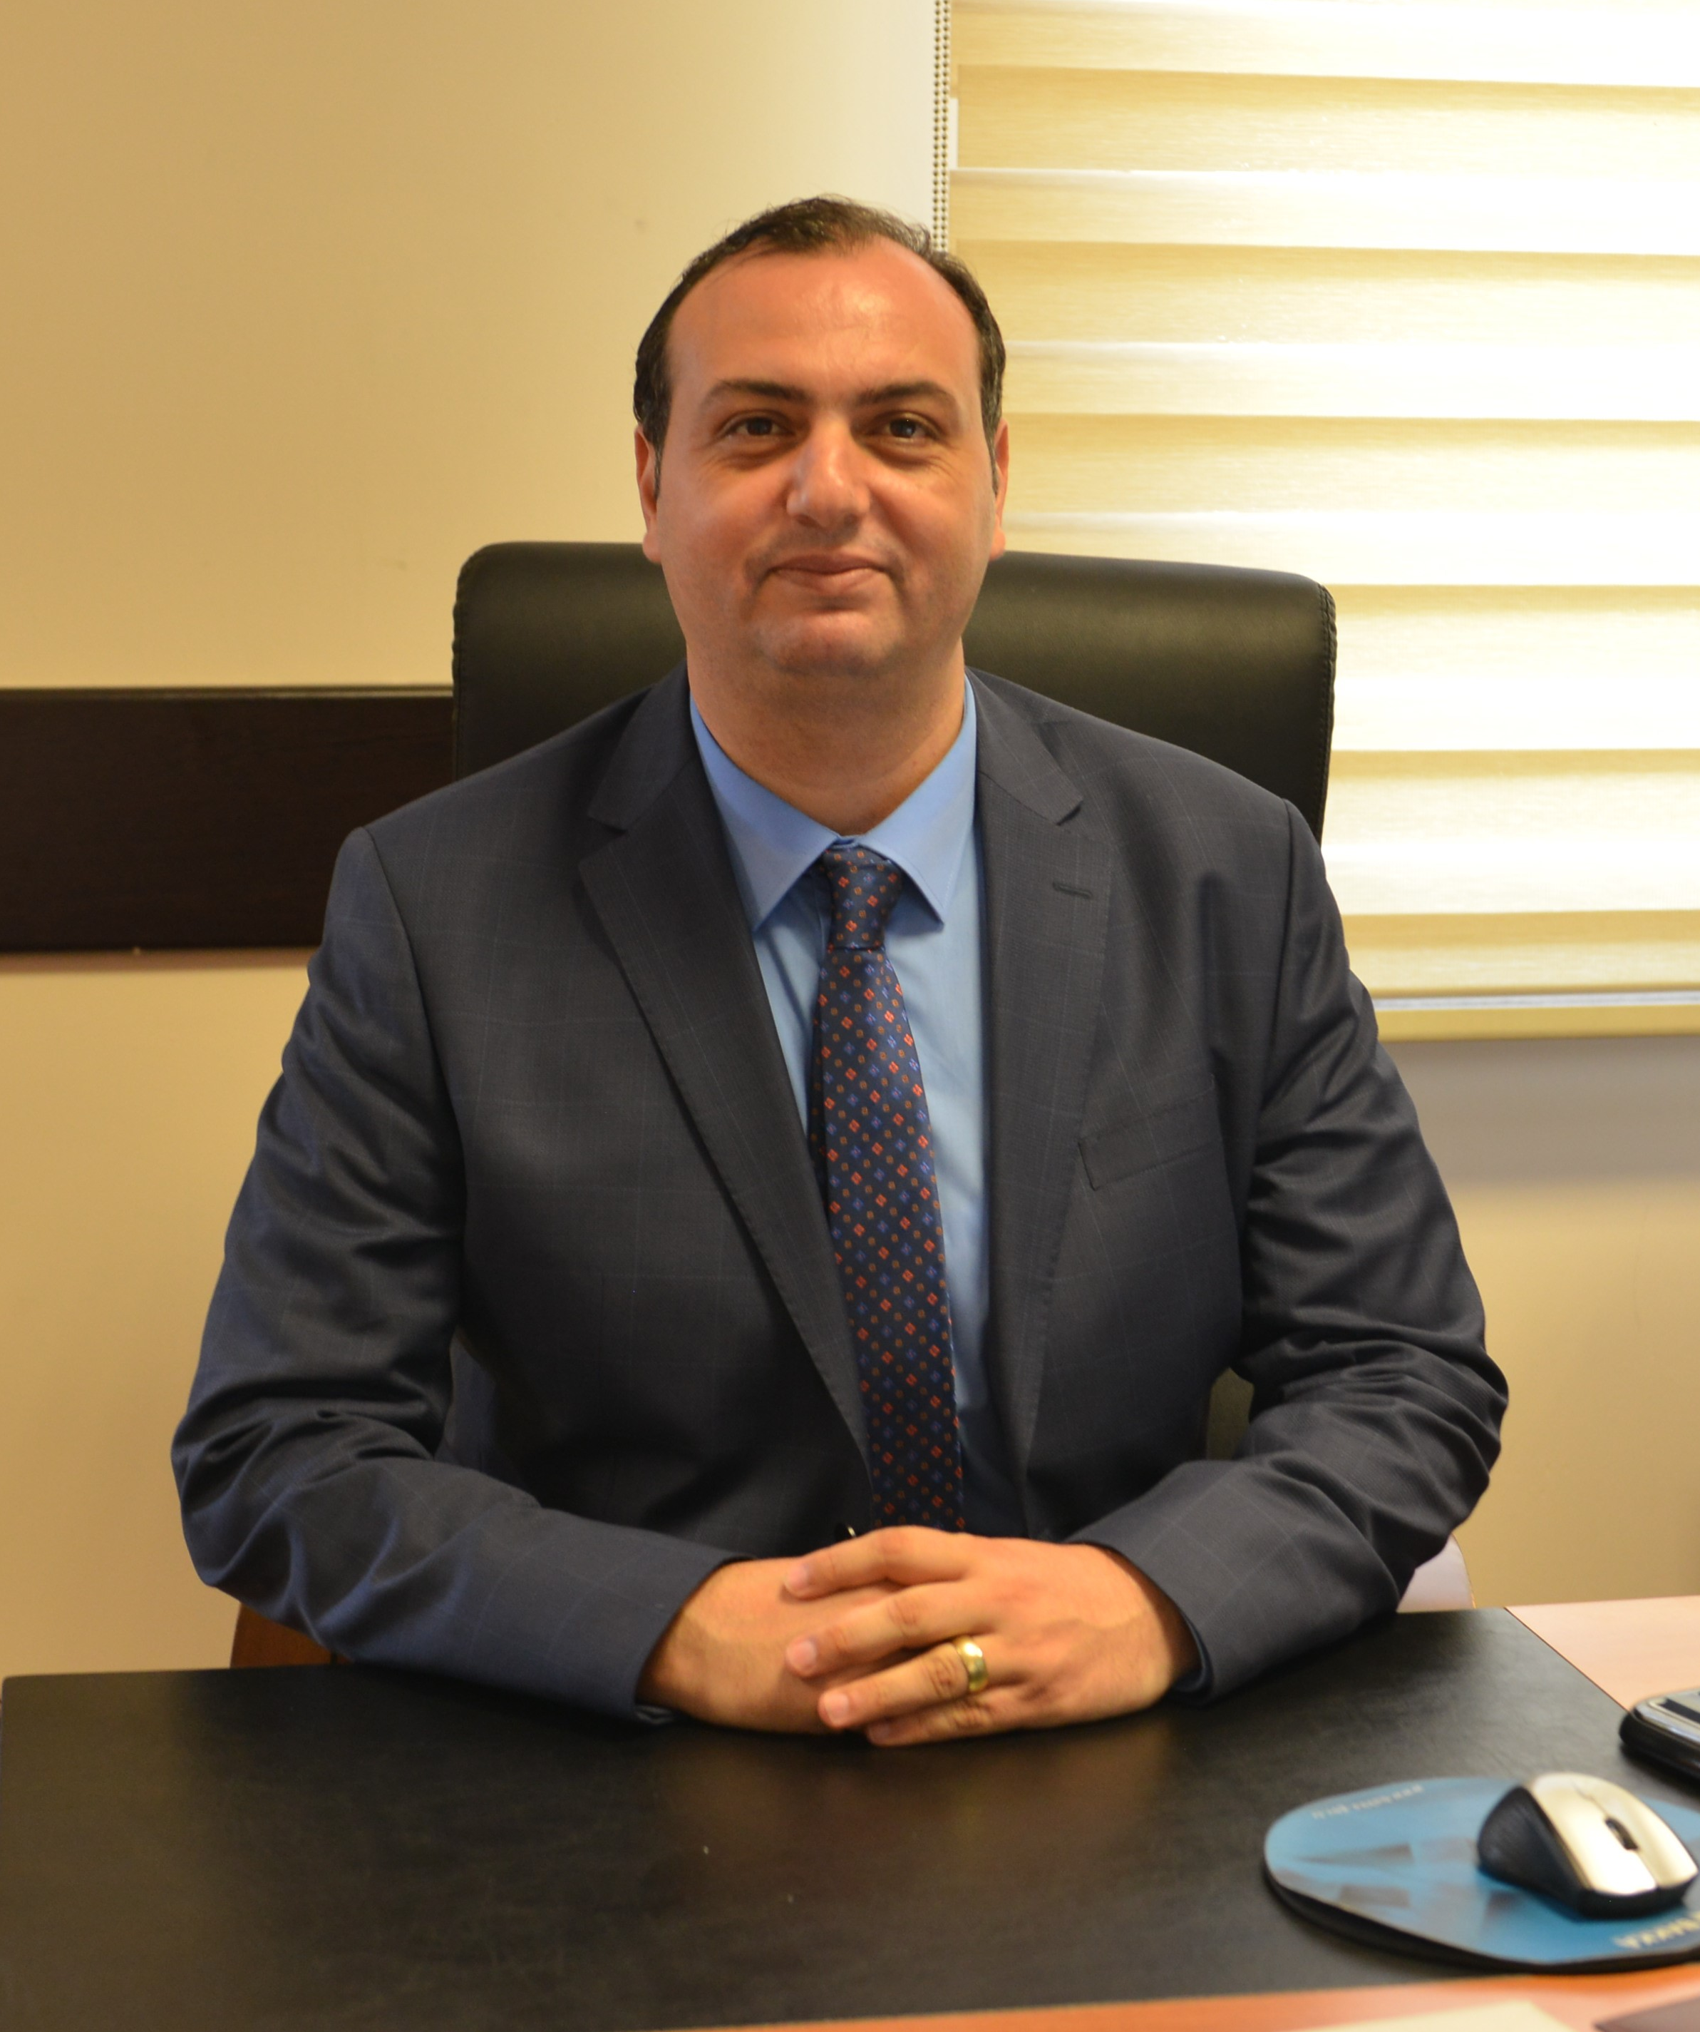
Silvikültür Anabilim Dalı
Prof. Dr. Erol KIRDAR Prof. Dr. Halil Barış ÖZEL Head of department

Slide 16
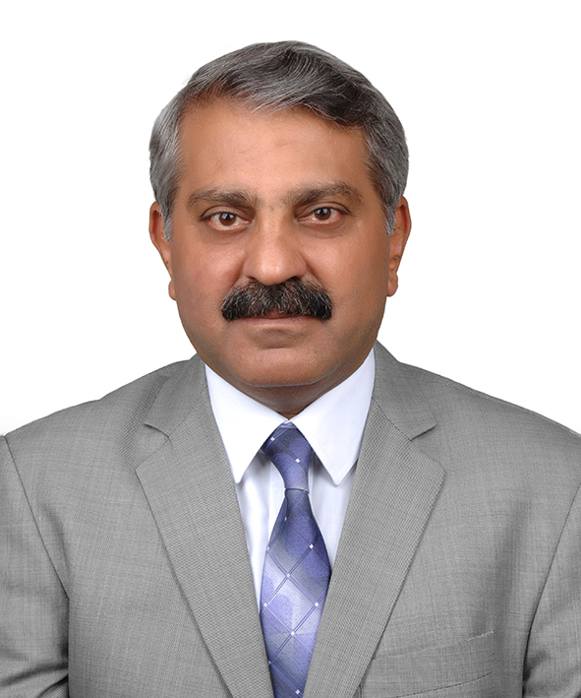

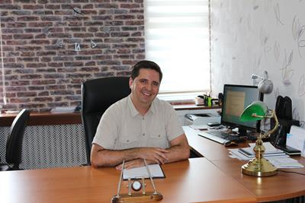
Ormancılık Ekonomisi Anabilim Dalı
Prof. Dr. İsmet DAŞDEMİR
Head of department
Doç. Dr. Ersin GÜNGÖR
Arş. Gör. Dr. Yağmur YEŞİLBAŞ KELEŞ

Slide 17
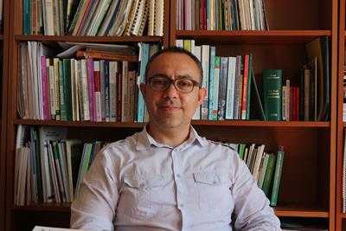
Ormancılık Politikası Anabilim Dalı
Dr. Öğr. Üyesi H. Batuhan GÜNŞEN
Head of department

Slide 18
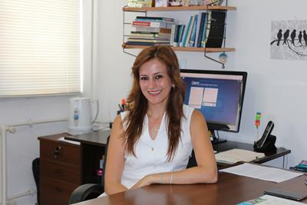
Ormancılık Hukuku Anabilim Dalı
Doç. Dr. Gökçe GENÇAY
Head of department
Deputy head of department

Slide 19
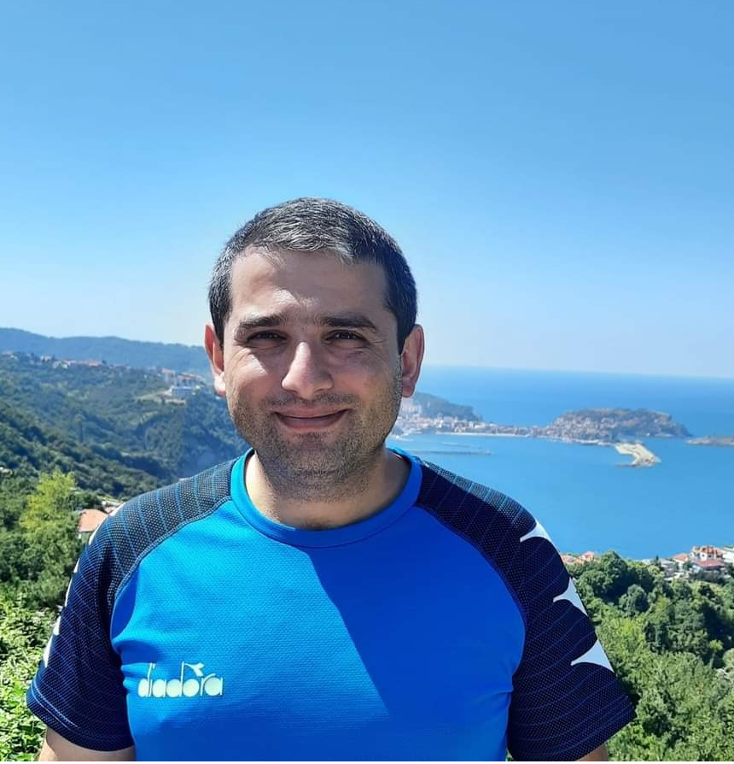
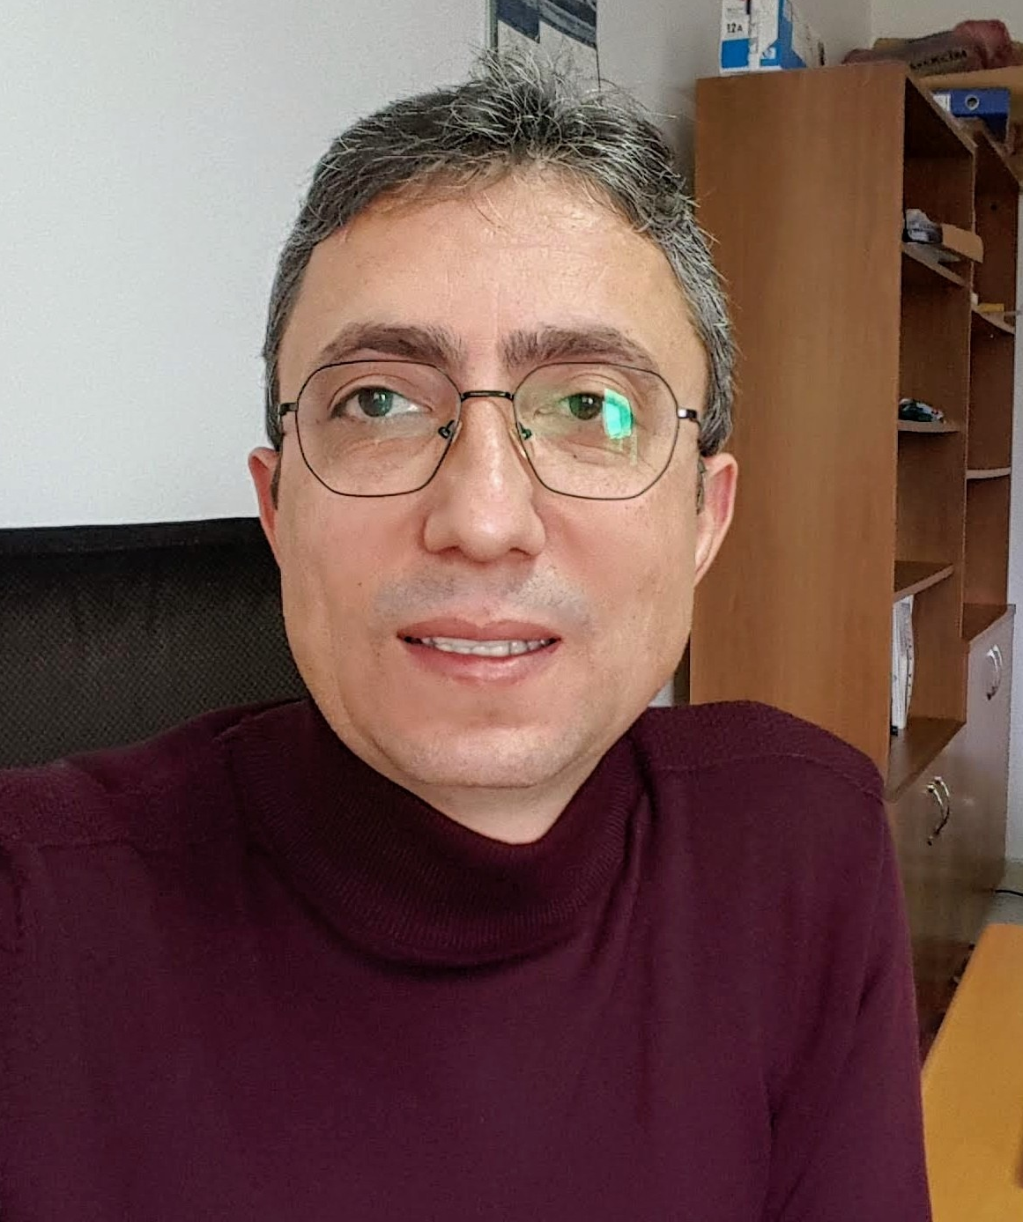
Toprak İlmi ve Orman Ekolojisi Anabilim Dalı
Doç. Dr. İlyas BOLAT Arş. Gör.Dr. Kamil ÇAKIROĞLU
Head of department

Slide 20
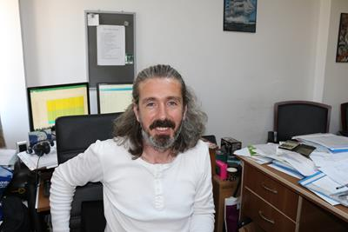
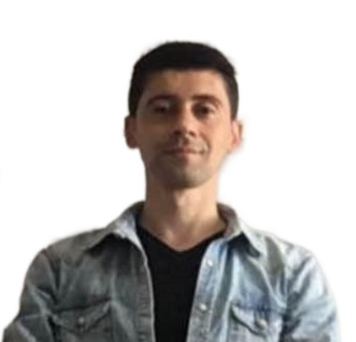
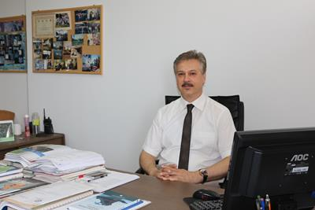
Orman İnşaatı ve Transportu Anabilim Dalı
Prof. Dr. Tuğrul VAROL Head of department
Prof. Dr. Metin TUNAY Dr. Öğt.Üyesi Tuna EMİR

Slide 21
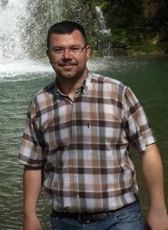
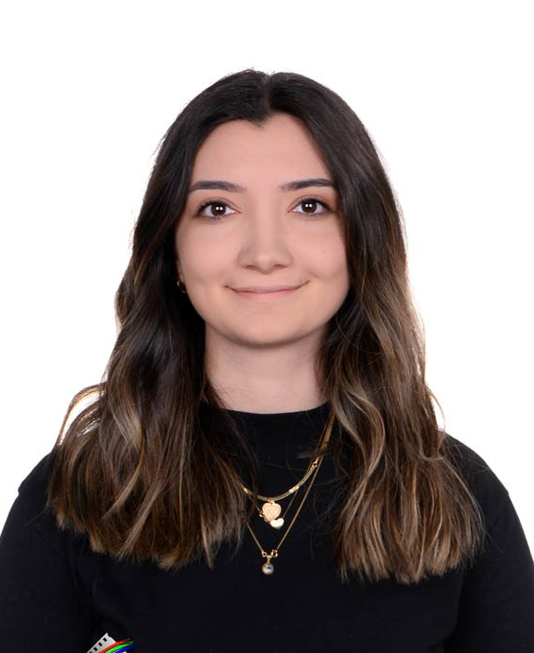
Ölçme Bilgisi ve Kadastro Anabilim Dalı
Prof. Dr. Ayhan ATEŞOĞLU Arş. Gör. F. Şevval BULUT
Head of department

Slide 22
FOREST ENGINEERING DEPARTMENT COURSES
Education duration: 4 years (8 semesters)
Courses are theoretical and practical,
Total 63 compulsory + 16 elective courses (2 of which are outside the department)
30 ECTS each Semester, 240 ECTS in total,
20-day Internship in 2nd and 3rd grades,
4th grade Graduation Thesis, Technical TripAcademic

Slide 23
Cooperation Programs within the Scope of ERASMUS: Forest Engineering (Bachelor - Master's- Doctoral)
  UNIVERSITY OF SOUTH BOHEMIA IN CESKE BUDEJOVICE (ÇEKYA)
  UNIVERSITY OF NAPOLI FEDERICO II (Italy)
  UNIVERSITA DEGLI STUDI DELLA TUSCIA (Italy)
  PRZYRODNICZY TECHNICAL UNIVERSITY (Poland)
  WARSAW UNIVERSITY OF LIFE SCIENCE (Poland)
  KROSNO STATE COLLEGE (Poland)
  UNIVERSITY OF TESSALY (Greece)
  INIVERSITAT POLITECNICA DE VALENCIA (Spain)
  WEST HUNGARY UNIVERSITY (Hungary)
  UNIVERSITY OF EVORA (Portugal)
  UNIVERSITY OF FORESTRY (BULGARIA)

Slide 24
Part Time Student Employment
In each academic year, a certain number of our students work part-time in our university's Library, Departments, Dean's Office, Course Laboratories, Education and Research Projects, Computer Laboratories, etc. It is employed to provide support in the units.
Quotas are announced on the website and bulletin boards by the Department of Health, Culture and Sports at the beginning of October or when necessary.
The announcement clearly states how many part-time students will be employed in which units and in what kind of jobs, the nature of the job to be employed, the conditions required for the students to be employed, the weekly working hours and the wage to be paid for one hour of work, the documents required for the application, the application location and date

Slide 25
IMAGES OF LABORATORIES IN OUR DEPARTMENT AND APPLICATIONS WITH STUDENTS

Slide 26

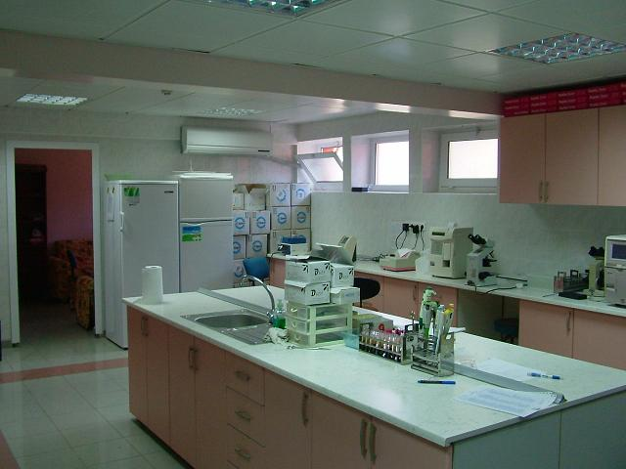
FOREST ENGINEERING DEPARTMENT LABORATORIES
Seed Technology and Silviculture Laboratory
Forest Botany Laboratory
Forest Entomology and Conservation Laboratory
Soil Science and Ecology Laboratory
Forest Management Laboratory
Watershed Management Laboratory
Forest Construction and Transportation Laboratory
Computer Laboratory

Slide 27
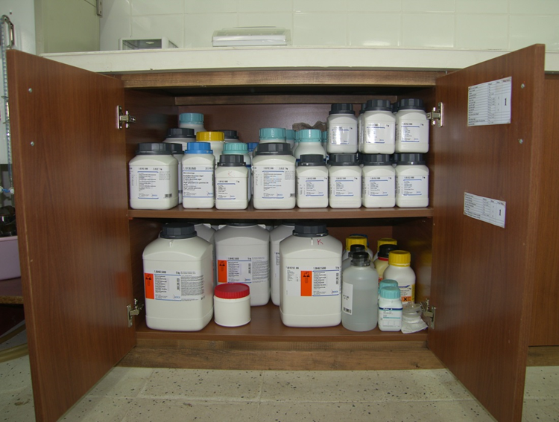
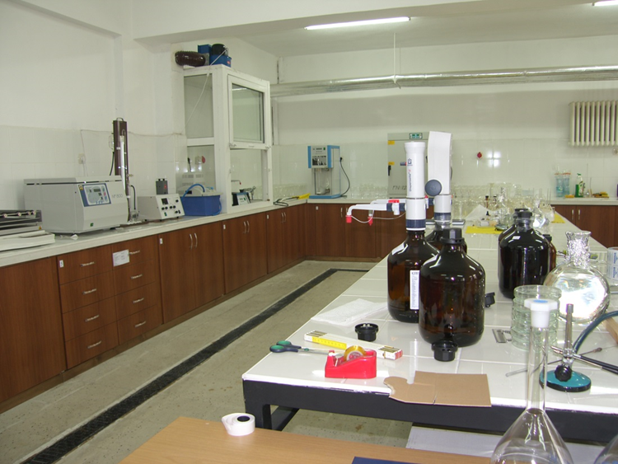
Soil Science and Ecology Laboratory
.
Many soil analyses for education, training and research purposes can be performed in this laboratory.

Slide 28
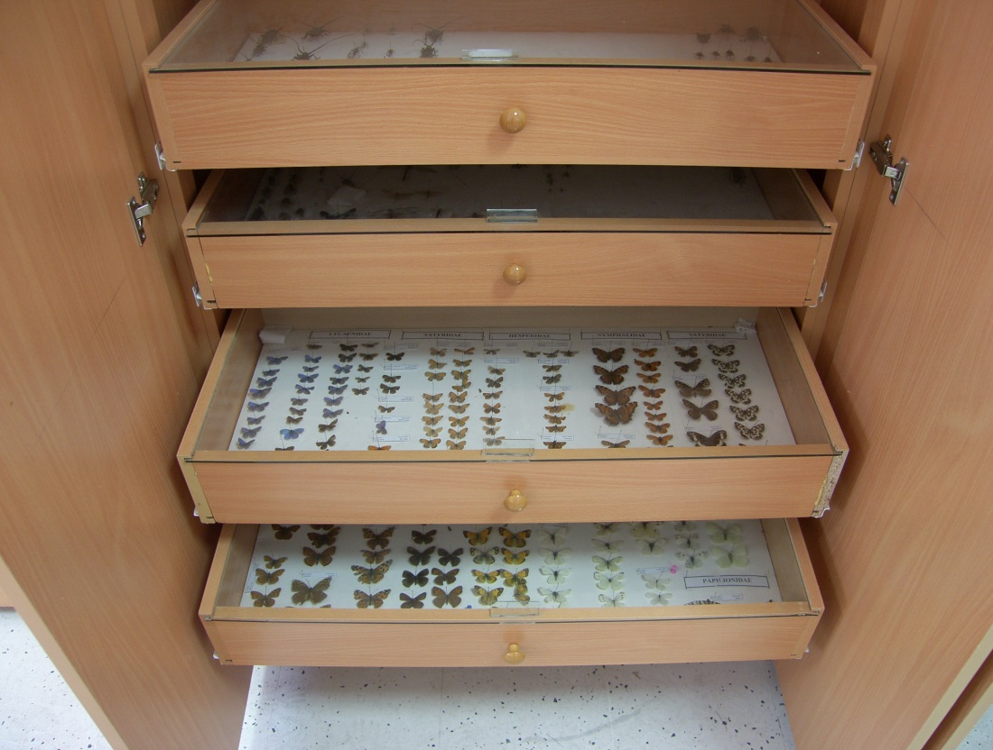
Forest Entomology Laboratory
Many insect species that cause damage in forests or are used in biological control are found in this laboratory.

Slide 29
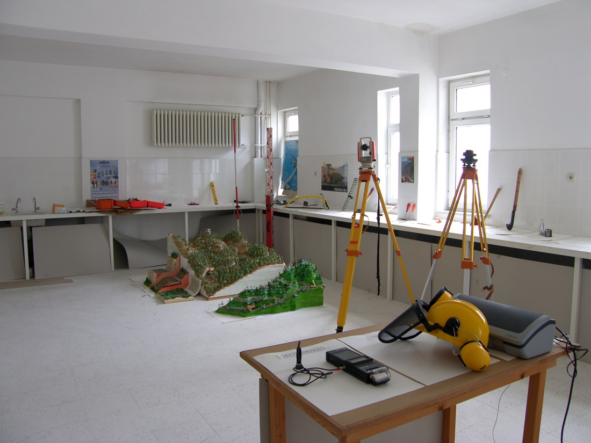
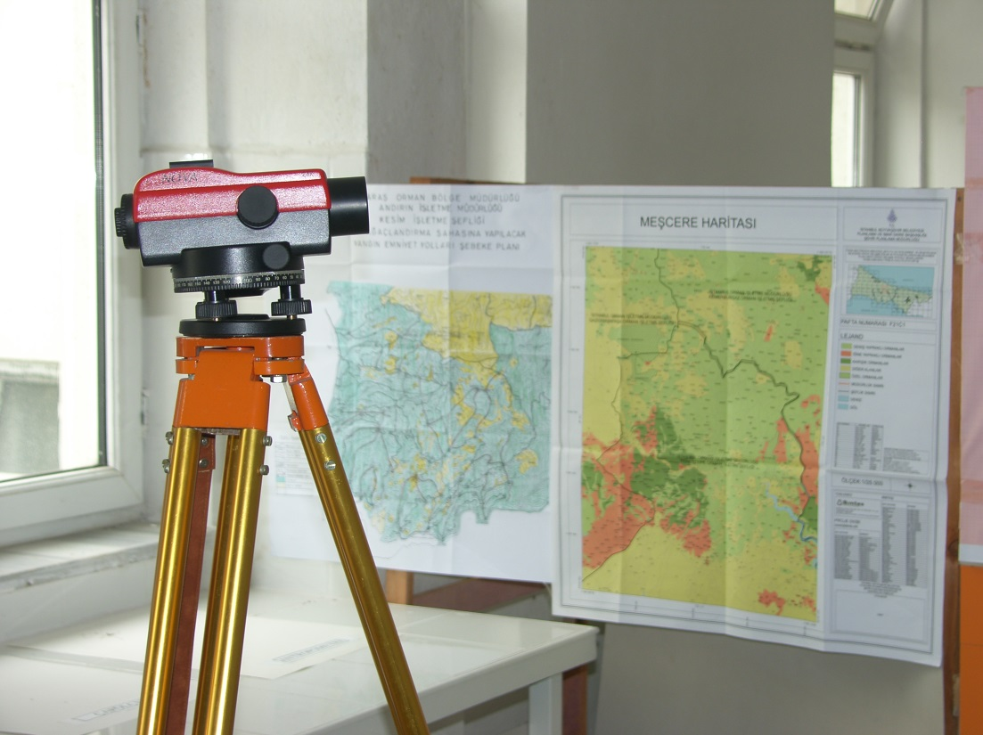
Forest Construction and Transportation Laboratory

Slide 30
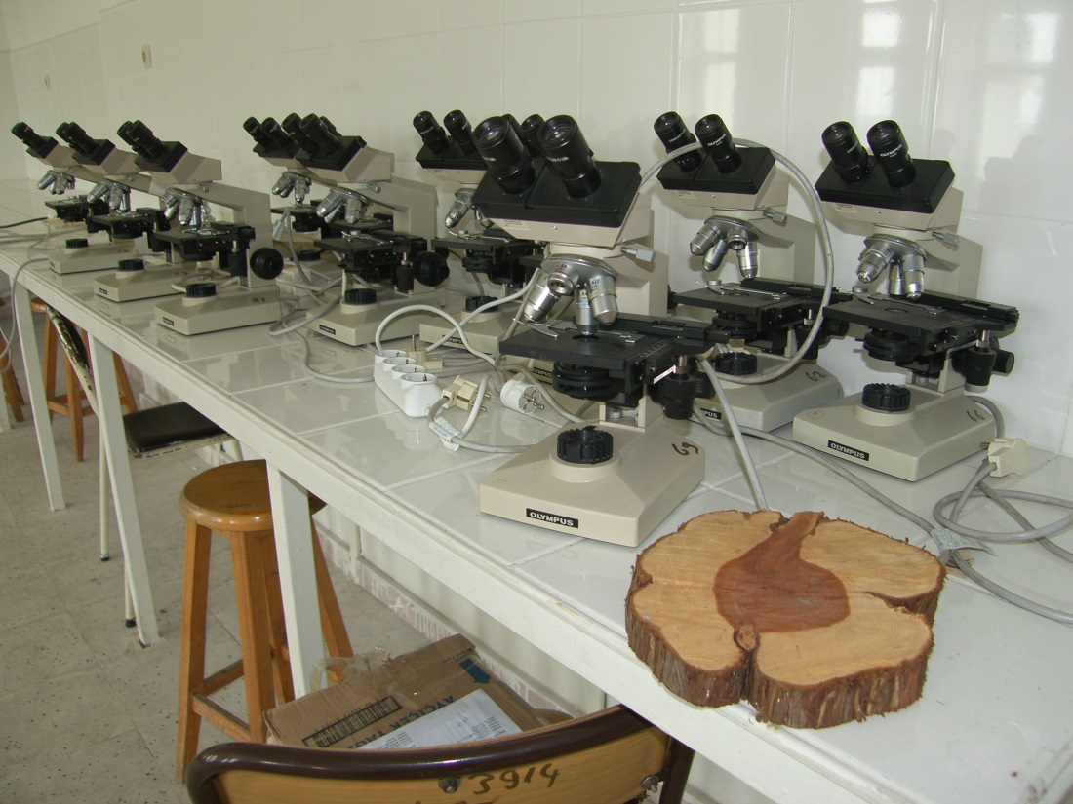
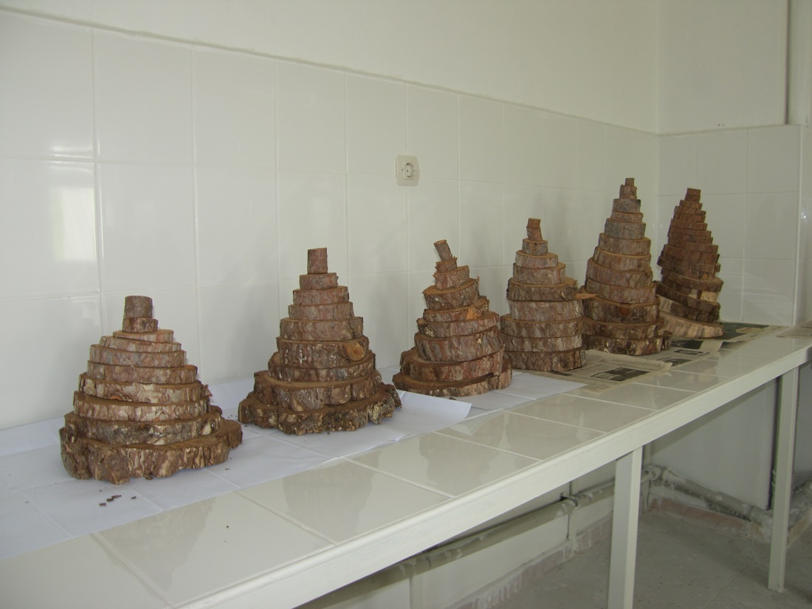
Forest Management Laboratory
It is the laboratory where processes such as photo interpretation and body analysis are carried out.

Slide 31
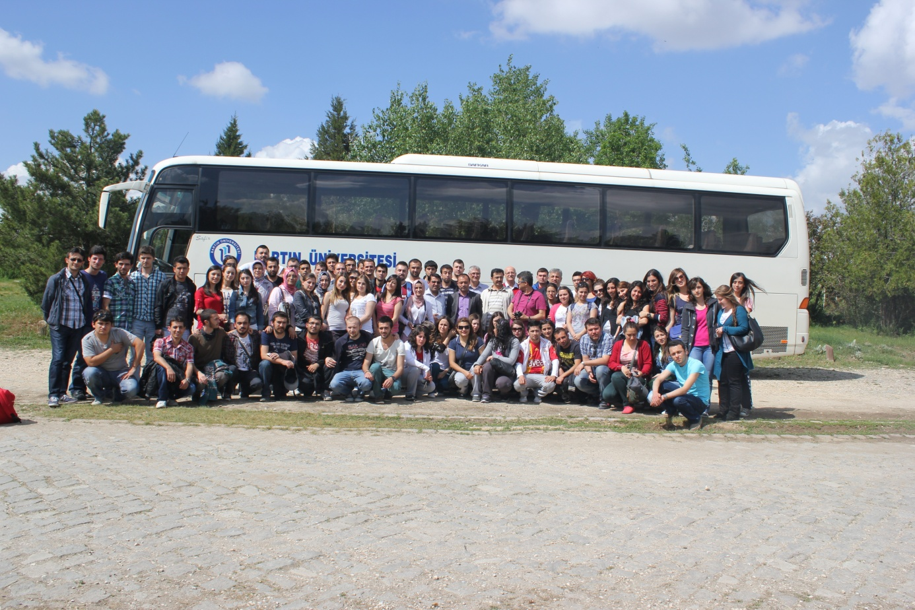
TECHNICAL TRIPS
Some of our courses are taught to our students in field conditions, making the information more permanent.

Slide 32
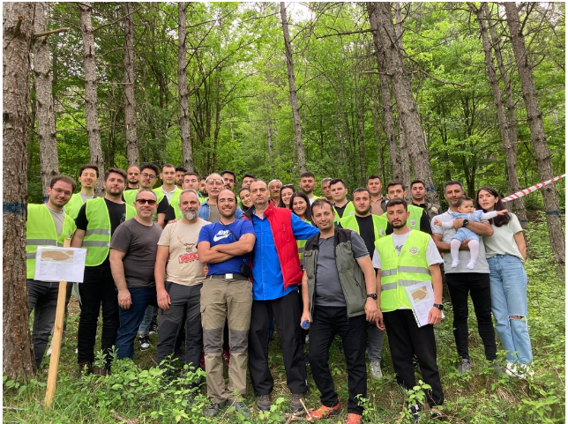
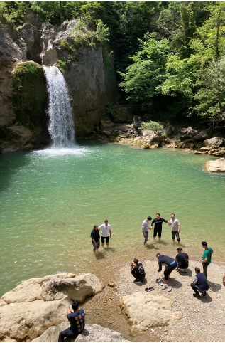
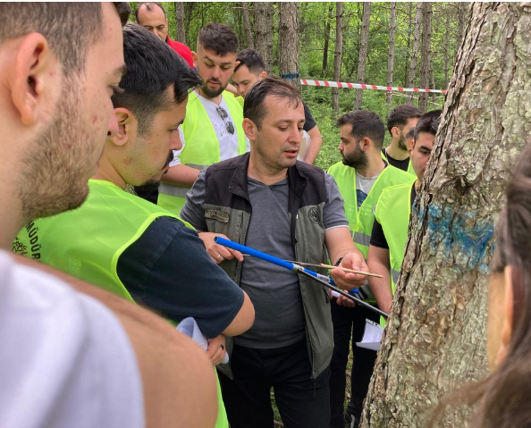

Slide 33
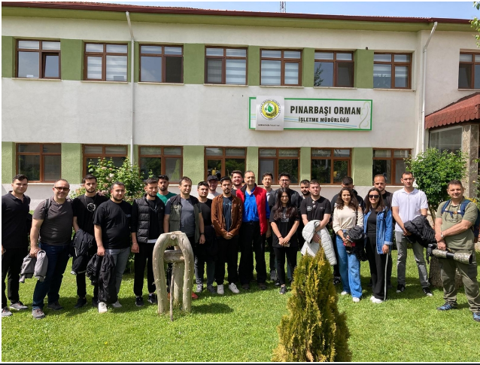

Slide 34
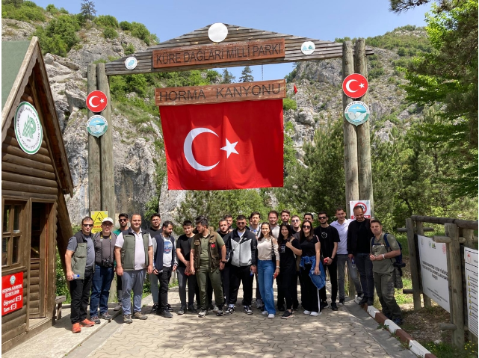

Slide 35
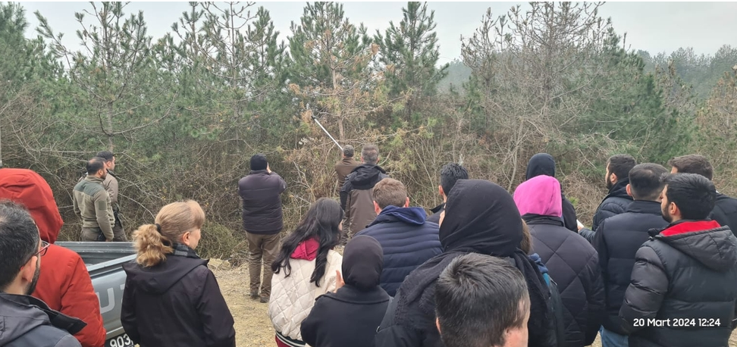




Slide 36


Slide 37


Slide 38



Slide 39

Field application carried out in Safranbolu-Ahmetusta location within the scope of Gymnospermae course

Slide 40

Field application carried out within the scope of "Nursery Techniques" course

Slide 41

Made within the scope of the "Engineering Design" courseproject presentations

Slide 42


Slide 43



VISIT TO NURSERY AND REJUVENATION AREA

Slide 44



Forest Fire Fighting Drill

Slide 45


VISIT TO FOREST WAREHOUSE

Slide 46

Forest Protection Studies

Slide 47

Cones Collected for Seeds

Slide 48

Forestry Week events

Slide 49


Slide 50



Slide 51


TÜBİTAK 2209-A PROJECTS
We are ahead of many universities in Turkey with many TUBITAK 2209-A student projects run by our students and advised by our professors.
We aim for the same success as our new students and contribute to the development of our students.

Slide 52

TÜBİTAK 2209-A PROJECTS
Bartın Faculty of Forestry students came first in TÜBİTAK 2209-A Student Projects in 2023 with the R&D and Quality Culture they adopted.
According to the announced TÜBİTAK 2209-A Student Projects 2023 results, 32 projects of our students were deemed worthy of support.
Our students ranked first in our University and among all Forestry Faculties with 32 accepted TÜBİTAK 2209-A Student Projects. The 81 TÜBİTAK Student Projects supported by our students in the last 3 years constitute 12% of the 680 projects supported in our University in the last 3 years. One in every three students studying at our faculty managed to produce a project.

Slide 53
MÜDEK
The Association for Evaluation and Accreditation of Engineering Programs (MÜDEK) is an independent organization that aims to contribute to the improvement of the quality of engineering education by conducting accreditation, evaluation and information studies for engineering education programs in various disciplines.

Slide 54
PURPOSE OF MUDEK
The aim of MÜDEK is to contribute to the improvement of the quality of engineering education by conducting accreditation, evaluation and information studies for engineering education programs in different disciplines, thus ensuring that the welfare of society is advanced by training better educated and more qualified engineers who understand current and developing technologies.

Slide 55


MÜDEK ACCREDITATION
As a result of its work in the field of quality and accreditation, Bartın Faculty of Forestry managed to be accredited by the Engineering Education Programs Evaluation and Accreditation Association (MÜDEK).
MÜDEK; During the accreditation process, the Forest Engineering and Forest Industrial Engineering Programs were examined according to different criteria such as education, research and development, physical infrastructure, laboratory facilities and academician qualifications. As a result of the evaluations, our Forest Engineering and Forest Industrial Engineering programs were accredited for 2 years.

Slide 56

GRADUATION CEREMONY

Slide 57


Slide 58





Slide 59

The day you share years of hard work with your families
…

Slide 60


Slide 61
Academic career
Master's Degree (2+1 years)Forestry Engineer ALES above 55 50%
Undergraduate GPA above 2.29 20%
Written exam 20% above 60
Foreign Language Master's Degree no limit 10%
TOTAL 60 Points
PhD (4+2 years)

Slide 62


THANKS
WE ARE A BIG FAMILY

